Slide 1
Jobs
What’s your job?
What do you do?

Slide 2
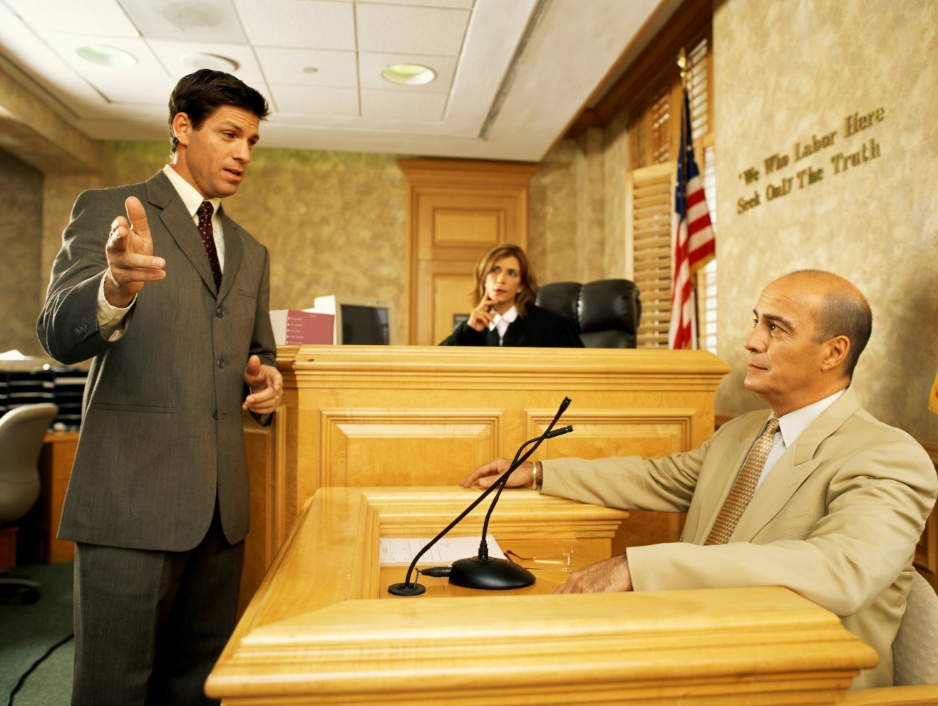
He’s a lawyer

Slide 3
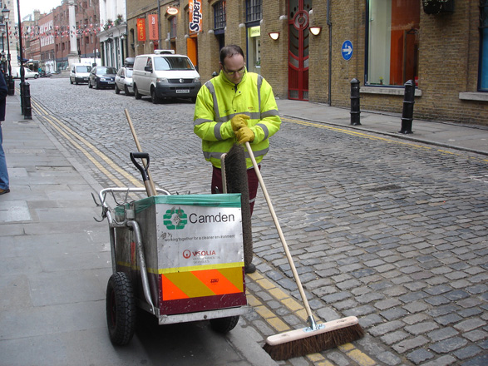
He’s a street cleaner.

Slide 4
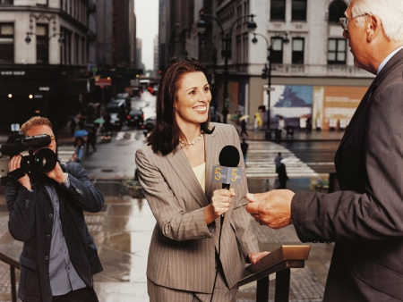
She’s a journalist.

Slide 5
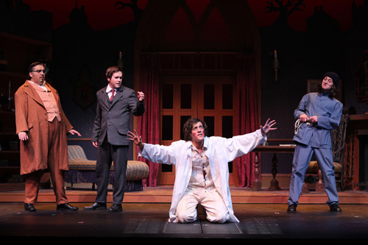
They are actors.

Slide 6
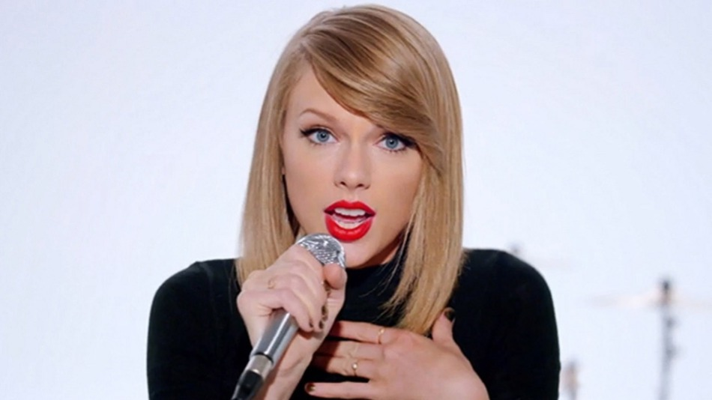
She’s a singer.

Slide 7
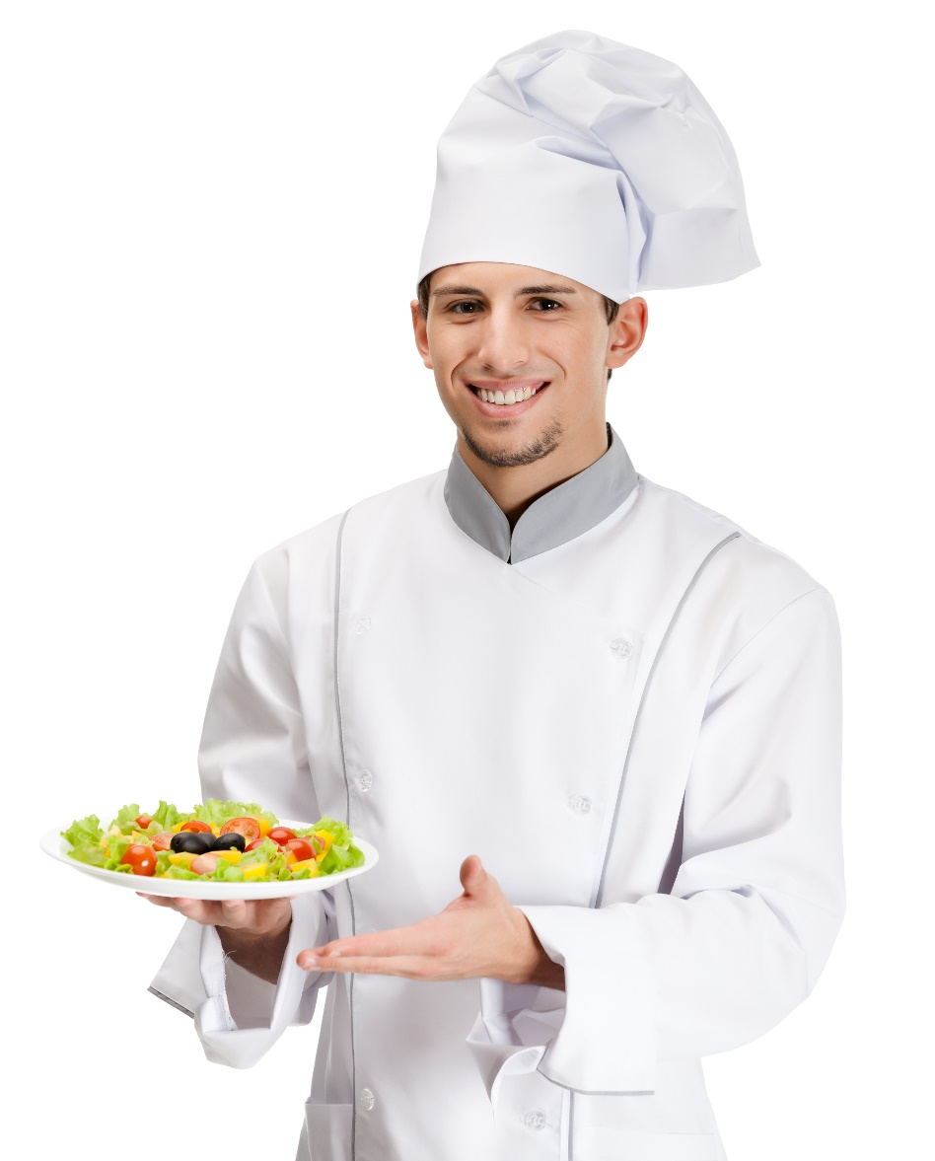
He’s a chef.

Slide 8
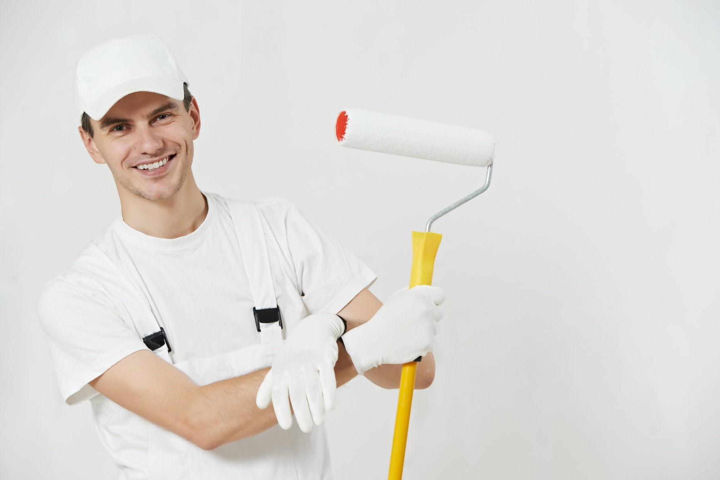
He’s a painter.

Slide 9
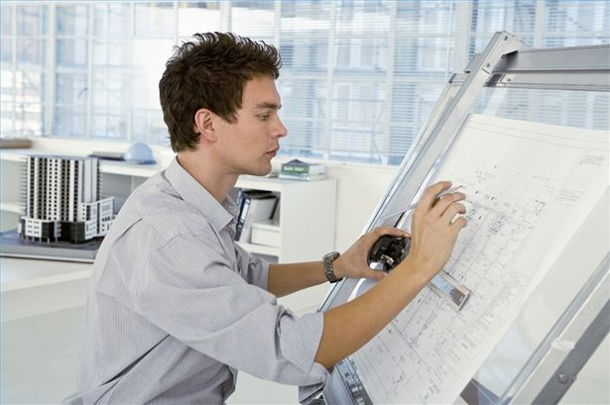
He’s an architect.

Slide 10

He’s a businessman.

Slide 11
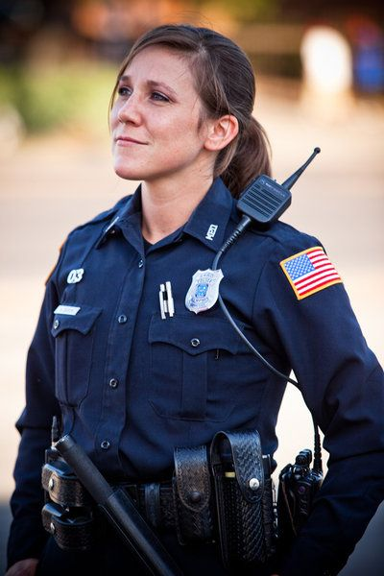
She’s a police officer.

Slide 12

He’s an engineer.

Slide 13
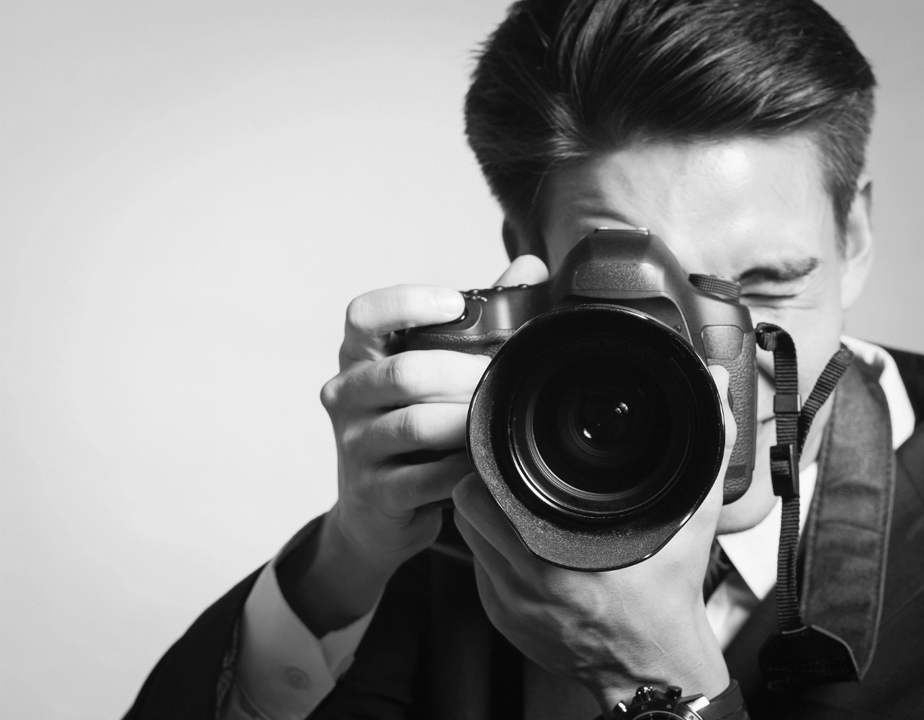
He’s a photographer.

Slide 14
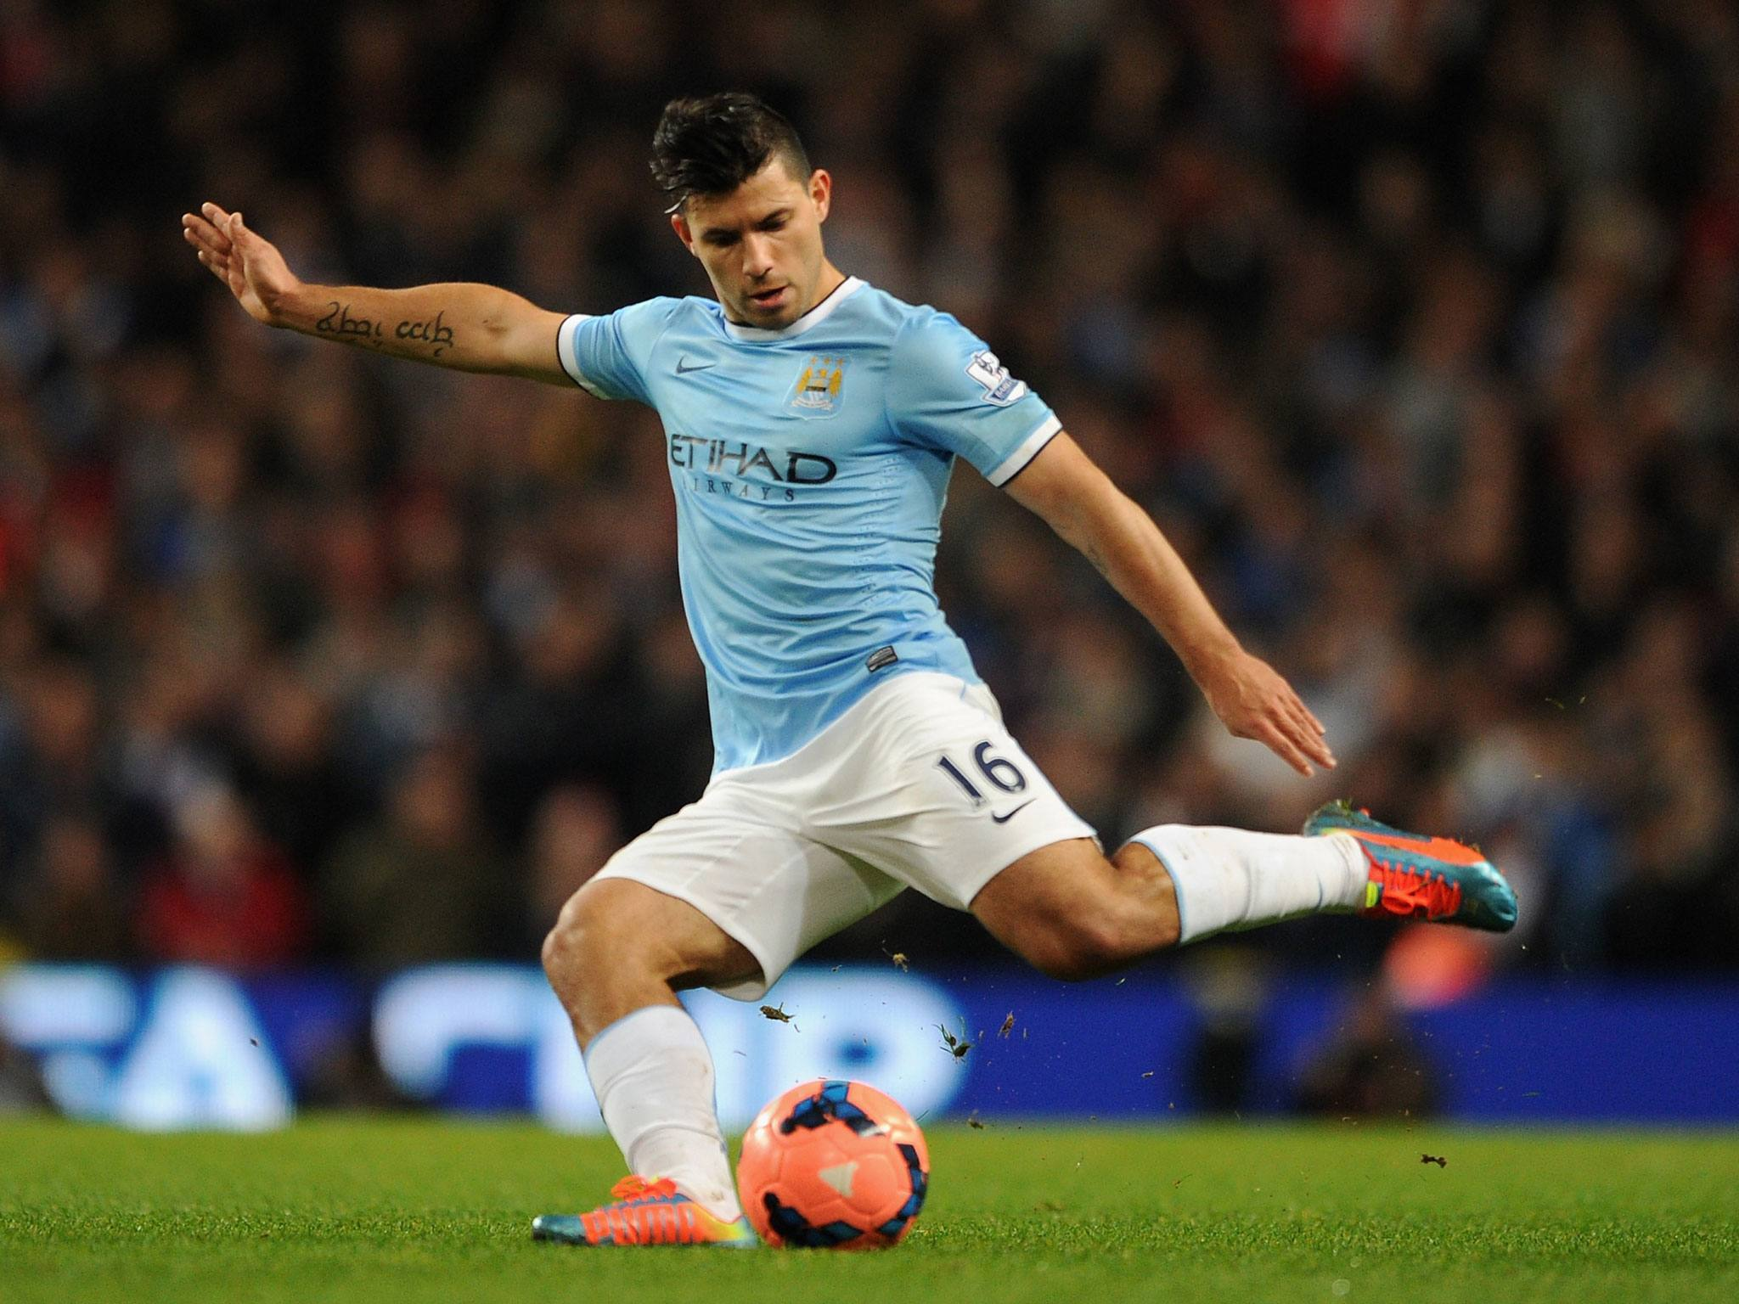
He’s a soccer player.

Slide 15
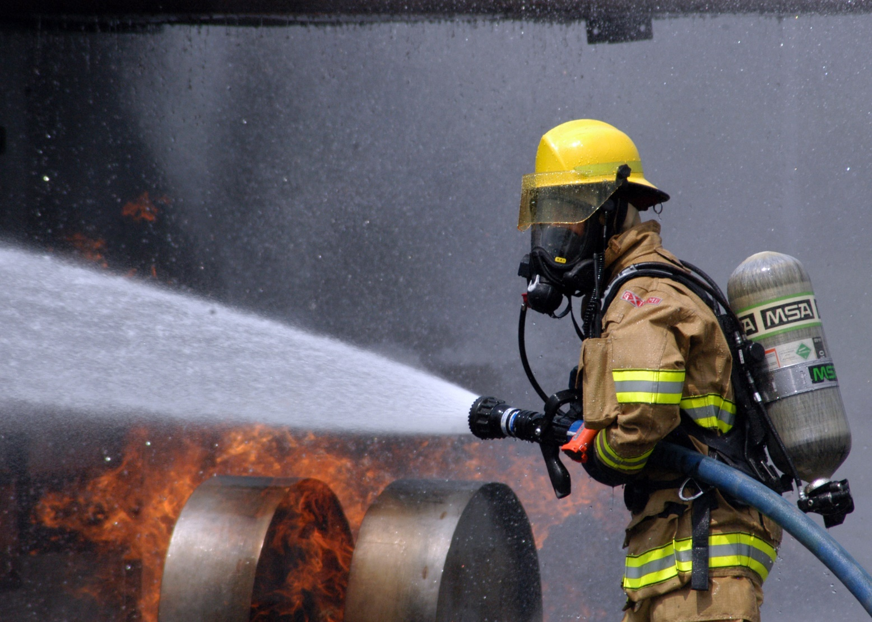
He’s a firefighter.

Slide 16
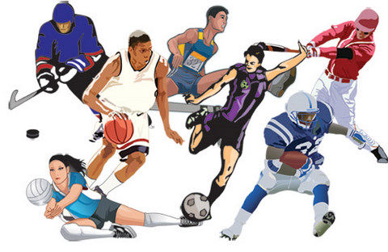
They are athletes.

Slide 17

He’s a gardener.

Slide 18

They are accountants.

Slide 19
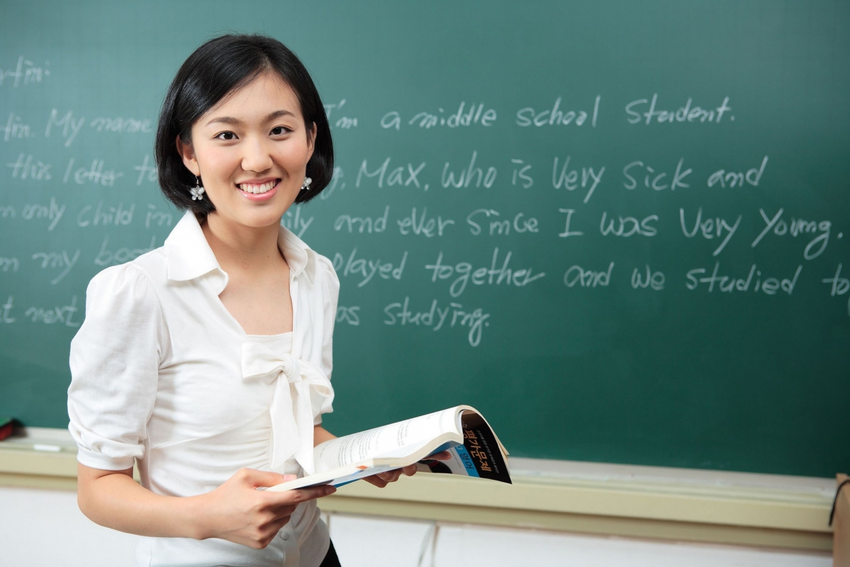
She’s a teacher.

Slide 20
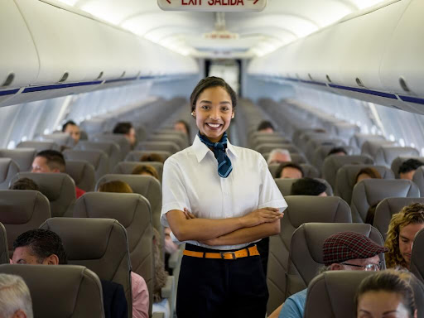
She’s a flight attendant / stewardess.

